Slide 1

EES Membership Survey 2021
Quantitative Results

Slide 2
EES Membership survey January 2021
Membership survey was released on 21 January 2021
Deadline was 3 February 2021
Dissemination was donoe via mailing, social media, EuropEval Digest (link in members-only part of the website when disseminated publicly)
Total of responses 66

Slide 3
Q1 Are you an individual or institutional member of the EES?
Answer Choices | Responses
Individual Member | 90,91% | 60
Institutional Member | 9,09% | 6
I am not sure | 0,00% | 0
 | Answered | 66
 | Skipped | 0

Slide 4
Q2 What country are you based in?
Nearly 70% of respondents are based in Europe
Overall top responding countries are:
  Switzerland (7)
  France (6)
  USA (6)
  Czech Republic (5)
  Netherlands (5)
  UK (5)

Slide 5
Q3 How long have you been a member of the EES?
Answer Choices | Responses
0-2 years | 30,30% | 20
3-5 years | 25,76% | 17
6-8 years | 19,70% | 13
9-10 years | 6,06% | 4
10+ years | 18,18% | 12
 | Answered | 66
 | Skipped | 0

Slide 6
Q4 In 2020, what were the main ways you interacted with EES?
(select all that apply)?
Answer Choices | Responses as % | No. of responses
Accessed the journal Evaluation | 60,61% | 40
Read the monthly newsletter EvalDigest | 51,52% | 34
Submitted an abstract for the EES biennial conference | 50,00% | 33
Checked the EES website for info on upcoming events, trainings, job opportunities | 46,97% | 31
Attended an EES-hosted online webinar | 39,39% | 26
Checked the EES website for resources on evaluation standards, glossaries, and handbooks | 34,85% | 23
Read at least 1 blog article | 33,33% | 22
Participated in a Thematic Working Group (TWG) | 21,21% | 14
Attended the AGM | 15,15% | 10
Used the database on COVID-19 & evaluation resources | 12,12% | 8
Submitted an abstract for a Professional Development Workshop | 9,09% | 6
Participated in an EES co-hosted activity: Futures Literacy Lab or ESCO definition of a M&E officer | 9,09% | 6
Listened to the podcast EvalEdge | 9,09% | 6
Used the database Gekiwiki on gender & evaluation resources | 3,03% | 2
 | Answered | 66
 | Skipped | 0

Slide 7
Q5 How do you access information about the EES? (select up to 3)
Answer Choices | Responses as % | No. of responses
EES website | 75,76% | 50
Emails from the EES Secretariat and President | 68,18% | 45
EES monthly newsletter EvalDigest | 40,91% | 27
EES social media accounts (Twitter, LinkedIn and Facebook) | 25,76% | 17
Contact an EES board member directly | 6,06% | 4
Other (please specify) | 3,03% | 2
 | Answered | 66
 | Skipped | 0

Slide 8
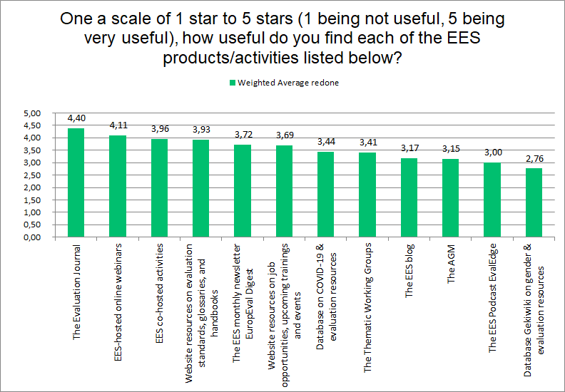
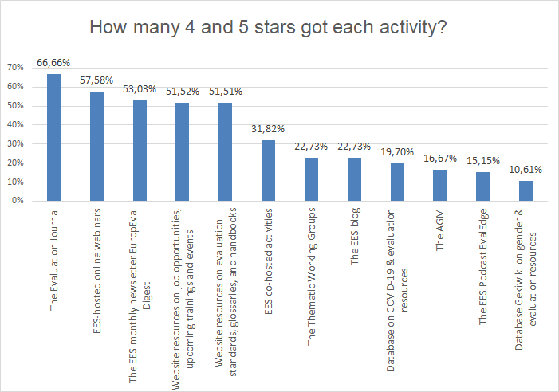
Q6 One a scale of 1 star to 5 stars (1 being not useful, 5 being very useful), how useful do you find each of the EES products/activities listed below?

Slide 9
Q8 Membership database
As suggested in the AGM, the EES is considering creating a database of its members that other members can search, called “finding evaluation experts,” to help our members network online. It would not be open to the general public. Would you be interested in using such a tool?
Answer Choices | Responses
Yes | 90,91% | 60
No | 1,52% | 1
I don't know | 7,58% | 5
 | Answered | 66
 | Skipped | 0

Slide 10
Q9 Would you be willing to share information about yourself in the proposed “finding evaluation experts” tool?
Answer Choices | Responses
Yes | 92,42% | 61
No | 0,00% | 0
I don't know | 7,58% | 5
 | Answered | 66
 | Skipped | 0

Slide 11
Q11 EES Biennial Conference / Visit Copenhagen
The EES is finalising its plans for its Biennial Conference to take place in 2021. To inform this decision, we would like to take our members’ preferences into account. Based on the current status of the COVID-19 pandemic and vaccine roll-out, would you be comfortable traveling to Copenhagen to attend an in-person event in September 2021, if the proper hygiene and social distancing measures were in place?
Answer Choices | Responses
Yes | 43,94% | 29
No | 25,76% | 17
I don't know | 30,30% | 20
 | Answered | 66
 | Skipped | 0

Slide 12
Q12 EES Biennial Conference / Online
Answer Choices | Responses
Hold all online events for 3 days in a row in September 2021 | 39,39% | 26
Hold online events throughout the year in 2021 | 40,91% | 27
I do not have a preference | 13,64% | 9
Undecided | 6,06% | 4
 | Answered | 66
 | Skipped | 0

Slide 13
Q13 On a scale of 1-5 (1 being not satisfied and 5 being very satisfied), how satisfied are you with your EES membership?
Overall average weighted score was 3.89

Slide 14
Q17 Do you have any other comments, observations, or suggestions you would like to share?
Thanks for asking for feedback
Keep up the good work!
Other main themes/comments:
  I hope there can be an opportunity to present at the biannual conference.
  How we can cover the Learning lose.
  I am looking forward to our continued cooperation.
Answered | 14
Skipped | 52

