Slide 1


Workshop
Steve Powell, Director
Gabriele Caldas, Outreach Coordinator

Slide 2
Who are we
This is work in progress!
It’s amazing!
We are flexible, responsive, get in touch! hello@causalmap.app

Slide 3
🔸
Plan
Poll - 3 min
Let’s get interviewed - 5 min
Motivation - 4 min
What’s QualiaInterviews? - 2 min
Qualia - Overview - 8 min
Hands-on Exercise - 20 min
Crafting the instructions - 3 min
Analysing your data - 2 min
Discussion (Finally…) - 10 min
Q&A - 15 min

Slide 4
Let’s get interviewed

Slide 5

🔸
Let’s get interviewed!
https://shorturl.at/7EET8
5 min
Notes:
5 min
Background: Increasing use of chatbots for data gathering: marketing research, customer service, sales, HR, etc. … but simple chatbots can be frustrating.

Slide 6
In the chat: how did you feel?
🔸
10 min
Notes:
potential response bias, for example towards younger respondents;
how much is an AI interviewer currently able to simultaneously follow the high-level gist of an interview guideline at the same time as managing difficult decisions about when to dig deeper on a particular topic and when to move on to a different line of questioning;
the need for human checking and validation of AI-generated results;
the extent to which an AI interviewer adopts the values and world view of the training data and as such might be in a sense producing results which serve to maintain that hegemony;
whether AI-assisted research can go beyond mere skill at behaving like a human researcher to assisting in or leading construction of genuinely new theory.

Slide 7
Motivation
Why AI-led interviews?

Slide 8
Face to face
Interviews
Conversational AI interviewing?
Quality
Structured questionnaires
Quantity
Notes:
Bigger because so many possibilities

Slide 9
☑️Questionnaires vs 🎤 Human-human interviews vs. 🤖 AI Interviews?
☑️
🤖
🎤
Rigid Adaptable / flexible
🤖
🎤
Insensitive Read between the lines
☑️
🤖
🎤
Predictable data Emergent, unexpected data
☑️
🎤
🤖
☑️
Slow to set up Fast to set up
🎤
🤖
☑️
🎤
Slow to administer Fast to administer
🤖
☑️
Slow to analyse Fast to analyse
🎤
🎤
🤖
☑️
Expensive Cheap
🤖
☑️
Noisy (Interviewer) Reliable/Reproducible
🎤
🤖
☑️
Noisy (Random) Reliable/Reproducible
🎤
🤖
☑️
Scaling: hard Scaling: easy
🎤
☑️
🤖
Multi-language: hard Multi-language: easy
🎤

Slide 10
DO: When to use AI interviewing
Situations where you don’t know exactly what to ask
Less structured, explorative conversations
When your respondents may use different languages
When you can scale up from H2H to AI interviewing
DON’T: When not to use AI interviewing
When you could have used a questionnaire with open questions
When you have a lot of specific questions to ask
When you are dealing with sensitive information
14 min

Slide 11
Qualia

Slide 12
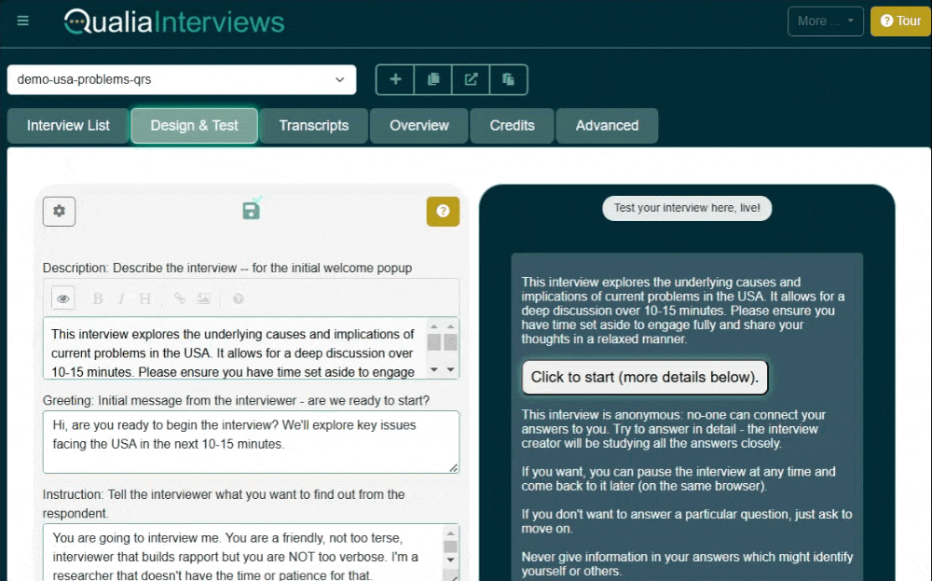
🔸
16 min
What’s QualiaInterviews?
A platform for designing and delivering AI-led online interviews.
“SurveyMonkey, but for stories”
One interview costs £1-2. You get £50 in credits if you sign up. No subscription.
How it works:
Design and test your interview
Send the interview link to your respondents
Analyse the transcripts
Alternatives:
Ailyze.com
Yasna.ai
Notes:
2 min

Slide 13
Qualia
Overview

Slide 14
Walkthrough of Qualia’s interface
Create, test and manage the interviews
User guide: https://www.qualiainterviews.com/documentation/
Notes:
10 min demo
5 min trying the interview
Setting up an interview
Using the Advisor
Interactive session: Participants experience being interviewed by the AI
Using the Transcripts and Overview tabs

Slide 15
Privacy and consent
Privacy
  At Qualia, all interviews are, by default, anonymous and we don’t store personally identifying information at all.
  Qualia stores data securely, but researchers should still be cautious with sensitive information.
Consent
  Ensure data anonymisation and compliance with privacy laws (e.g., GDPR).
  The introductory pop-up, which includes your Description text is designed to get informed consent.
Notes:
Qualia is instructed to not accept personal information such as the names of the respondents, but the level of anonymity needs to be decided by the author of the interview

Slide 16
Multi language!
It’s cool!
Look at the docs

Slide 17
What instructions to give the AI?
You have a lot of flexibility. 10 overlapping tools in one.
Match your design to your analysis plan
Highly structured
Loosely structured
Conditional logic
Iterative questioning
  Causal mapping
  Social network diagrams
Digging deeper
Iterate a hypothesis
“Thinking models”
Notes:
5 min

Slide 18
🔸
What if it “isn’t working”??
Tweak the instructions. Test. Iterate.
Don’t overload it
Notes:
5 min

Slide 19
🔸
Preparing to launch
Test interviews before full deployment
Monitor for inconsistencies and adjust the interview design as needed
Document the steps you took
Use learnings from each round to refine the interview design: it’s an iterative process
24 min

Slide 20
Breakout

Slide 21
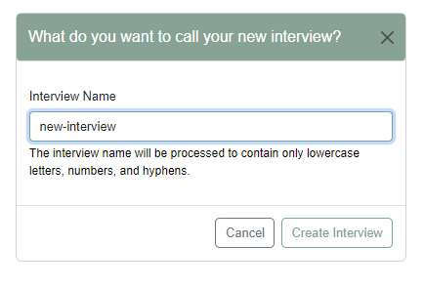
🔸
Exercise:
Designing an AI-led interview with Qualia
STEP 1
Creating a new interview
Give your interview a name
Notes:
20 min total

Slide 22
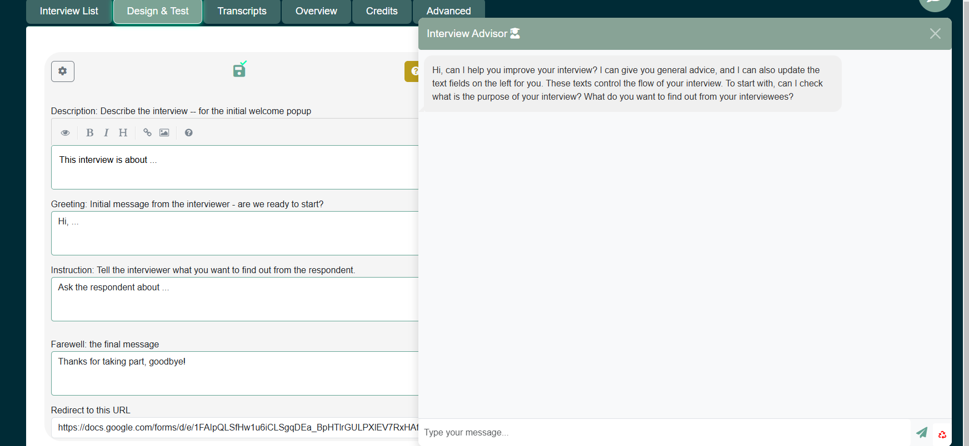
🔸
Exercise:
STEP 2
Writing the interview instructions:
You can edit the texts directly and/or use the Interview Advisor
Identify your research objectives → Plus, are there any specific questions that need to be answered?
Define your target audience → this helps the AI identify the correct tone to talk to the respondents

Slide 23
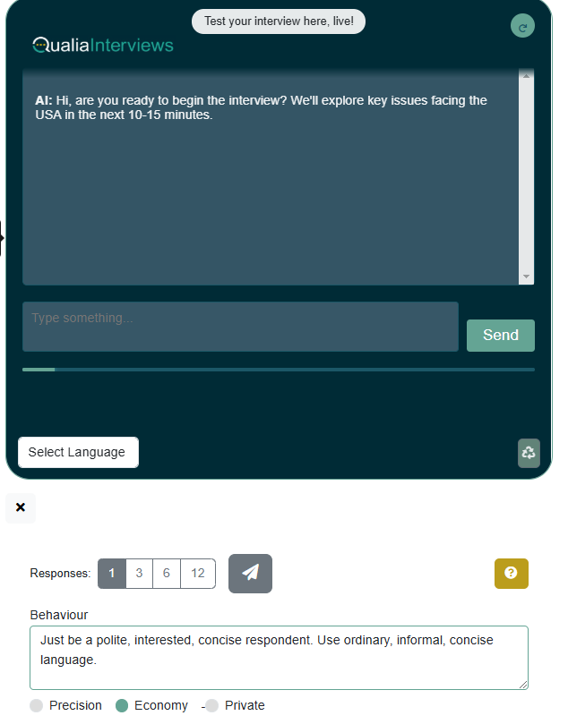
🔸
Exercise:
STEP 3
Testing the interview:
Manually
With the Automation panel (with different personas)

Slide 24

Your task in the breakout rooms
Agree on a simple interview you can start to create together: Context, audience, What do you want to find out?
One of you (“the editor”) with a good wifi connection and a google account: log in at https://edit.qualiainterviews.com/ .
Decide a name for the interview
Editor uses the Interview Advisor and/or edit the interview texts directly. (Don’t all try to edit the interview together.)
Editor tests your interview inside the editor interface
Editor sends the link to the others to test
Editor continues to tweak the Interview Texts
Editor views the Transcripts and Overview
edit.qualiainterviews.com/
User guide:
qualiainterviews.com/documentation/
You won’t finish all of this!
Main thing is to explore!
Ask for help in Zoom
😃😃😃
Notes:
10 min demo
5 min trying the interview
Setting up an interview
Using the Advisor
Interactive session: Participants experience being interviewed by the AI
Using the Transcripts and Overview tabs

Slide 25
Feedback from breakout sessions
In the chat:
what worked
what didn’t work?
44 min
Notes:
5 min

Slide 26
Qualia
Crafting the instructions

Slide 27
🔸
What instructions to give the AI?
= Like any other interview!
Best Practices
Have an aim: (research aims, not predetermined questions)
Listen actively
Build rapport
Probe for deeper insights
Embrace Flexibility: Explore emergent topics that arise.
Summarize Periodically: To ensure mutual understanding.
Guide the Discussion: To align with your research objectives, while remaining open to unexpected insights.
Common Pitfalls to Avoid
Avoid Rushing: Respect the natural flow of the conversation that may lead to richer insights.
Steer Clear of Leading Questions
Notes:
5 min

Slide 28
🔸
Tips for writing the instructions / interview guide
The QualiaInterviews platform already has some basic instructions to guide the interviewer behaviour, you can build on those.
Think of the AI interviewer as a human intern. They will need very clear instructions to be able to conduct the interviews in the right way.
Look at your instructions as the AI would see them. The AI will seem to not always follow your instructions exactly. This doesn't mean the AI is "broken" or “stupid”, it usually means you need to tweak your script.
Start simple: so you can get the hang of it.
Be clear and specific: If it’s hard for a human to understand it, it will be hard for the AI.
Experiment with different approaches until you find the one that best fits what you want.
Try the “Precision” model. These can follow longer and more complicated instructions.
Contextualize: Provide enough context for the AI to understand what you want, and describe your target audience.
Keep it short: In principle, you can ask the AI to keep any number of things “in its head” while constructing a response but in practice it seems it can end up getting confused (like a human).
Use structure: Use sections, starting with a clear and concise statement of what you want the model to do, then provide the required context, then the specific instructions.
Give examples. But check the AI does not get too distracted by these and use them too often.
47 min
Notes:
10 min

Slide 29
Consider using special interview strategies
= Definitely not a fixed question-by-question approach
The interviewer adopts a certain style and adapts to the flow of the conversation (based on the instructions you give the AI).
Causal backchaining: which you saw in the USA problems interview example. For when you would like to get information about your respondents’ mental models of what influences what in their world. This is the kind of questioning that we use with when we want to do causal mapping on the final transcripts.
Social network questions: who is linked with whom and how? And who is linked with them?
Laddering techniques (Rietz and Maedche, 2022): to uncover the underlying attributes, consequences, and values (ACV) associated with participants' experiences of the topic discussed.
Notes:
10 min

Slide 30
Analysing your data

Slide 31
Analysing your data
Global analysis (Leaves a lot of responsibility to the AI. Overview of trends and patterns across all interviews. You can also ask specific questions, like: what did the respondents mention about climate change?)
Using the Overview Tab
or upload transcripts to, for example, ChatGPT.
Detailed analysis
Respondent-by-respondent and/or line-by-line: more verifiable/transparent, eg:
causal mapping
social network analysis.
49 min

Slide 32
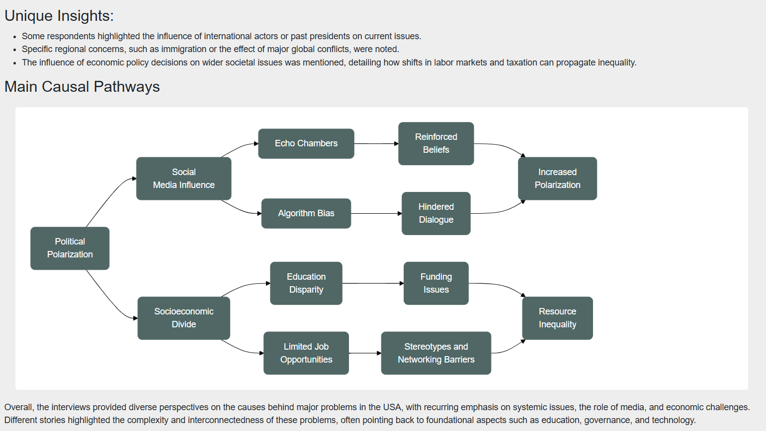
Analysing your data: simple overview
Part of the output from the Overviews tab of an interview about problems in the USA
49 min

Slide 33
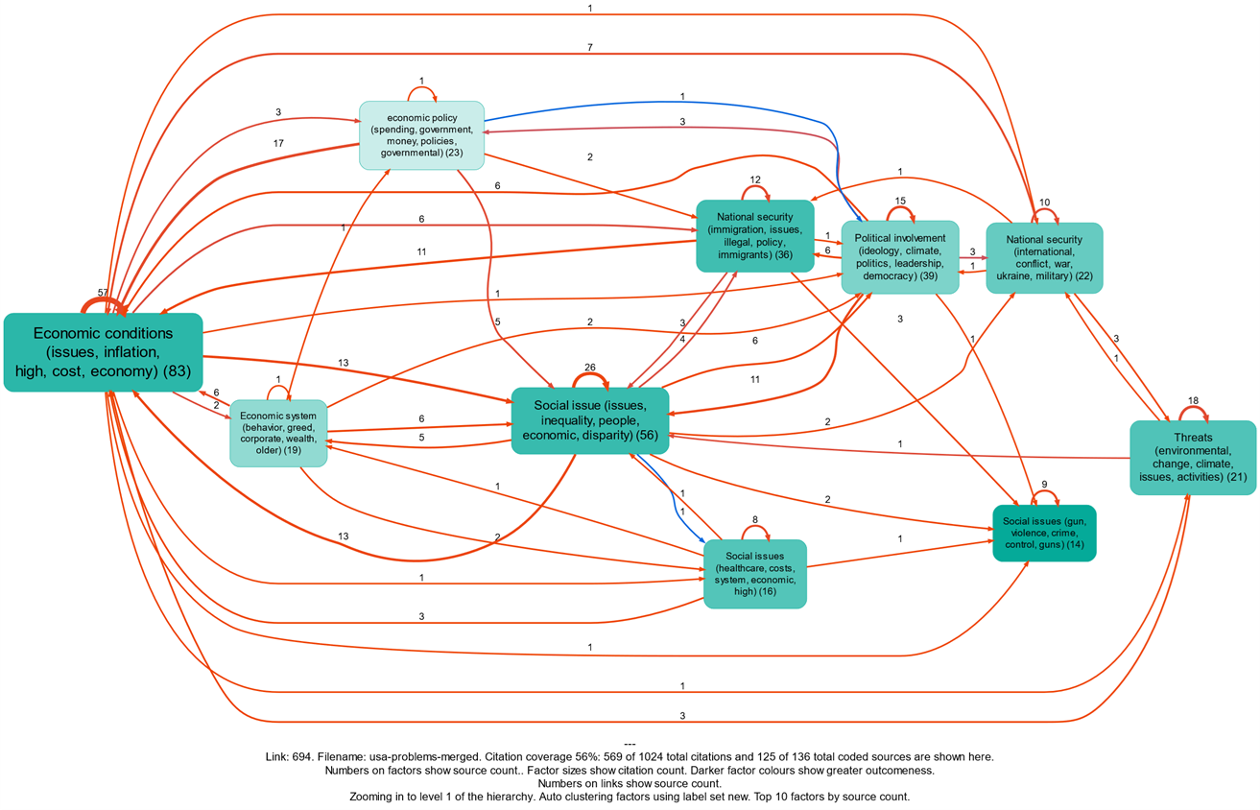
Analysing your data: a detailed analysis
Example of causal mapping of an interview about problems in the USA.
This analysis was conducted systematically by coding causal claims (with AI) line by line, rather than just asking the AI for an overall summary.
Orange lines are negative links.
Blue lines are positive links.
49 min

Slide 34
Finally…

Slide 35
Limitations (what do you think?)
Stochastic nature of conversations (they can "wander off"…)
Missing subtle cues, (non-verbal!)
Lack of rapport
Limited intervention for distress, whistleblowing, safeguarding…
AI is not “neutral”: its responses are based on training data, which may contain inherent biases. Try to mitigate with explicit instructions to take a specific stance.
Inclusivity: access to internet and literacy.

Slide 36
The researcher’s role
AI interviews as a way to scale rather than replace human-led interviews.
Design and oversight: The researcher's role is more about designing and overseeing the interview and less about direct interaction.
Ethical considerations: Ensure informed consent, considering participants' understanding of AI involvement in the interview process.
Data interpretation: Interpreting and analysing the data becomes even more critical, accounting for the AI's influence on the interview dynamics.
Quality control: Continuous monitoring and adjustment of the AI's performance is essential to maintain data quality and integrity.
Responsibility: Take full ownership of the ethical implications of using AI: the AI is only a tool, it’s the researcher's responsibility to make decisions.

Slide 37
🔸
Strategies for maintaining rigour/transparency
Iterate: design → test → check → improve and document decisions you made.
Providing clear explanations of AI's role in the evaluation.
Avoiding over-reliance on AI-generated summaries without human oversight.
Remember the ‘tips for writing the instructions’ slide

Slide 38
Extra free credits to use Qualia!
Get extra £100 on top of the £50 credits you get when you register
  to conduct up to 150 interviews for free!
Submit your proposal to gabriele@causalmap.app until March 28th:
  a short, succinct proposal (less than 500 words) saying how you would like to include QualiaInterviews in your research.
All applications are welcomed, but proposals regarding research on diversity equity and inclusion will be given preference.
Accepted applicants are expected to write a blog post about their experience with Qualia within 2 months.
When we approve your application we will send you details of how to access credits and how to get support when using QualiaInterviews.
60 min

Slide 39
Q&A

Slide 40


Thank you!
Steve Powell
Co-founder and Director - Causal Map
hello@causalmap.app
Gabriele Caldas
Outreach Coordinator - Causal Map
gabriele@causalmap.app
Visit QualiaInterviews.com

Slide 41
Annexes

Slide 42
A case study

Slide 43
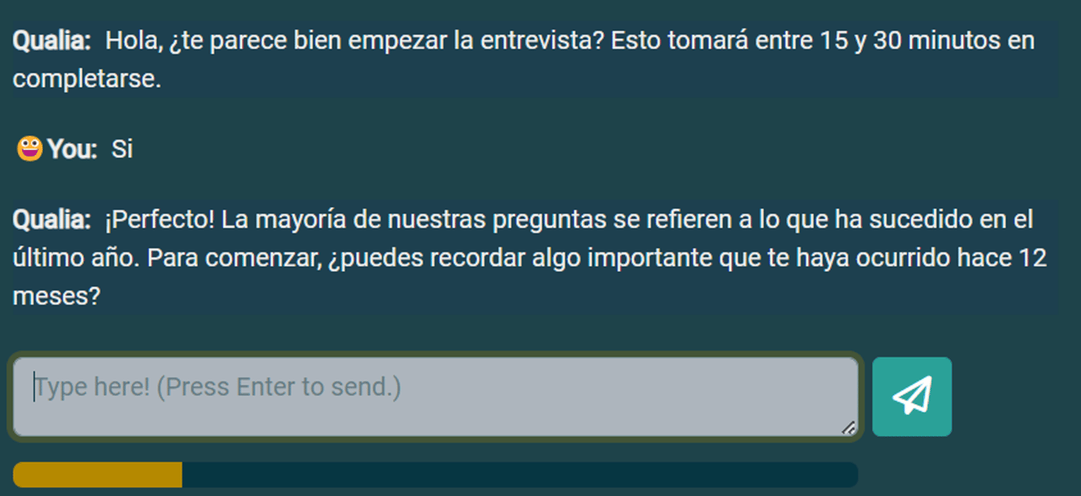
🔸
A real-world case study using Qualia
Background
DuocUC, a higher education institution in Chile, hired our consultancy (Causal Map Ltd) to conduct QuIP-style interviews with Qualia and analyse them using the Causal Map app. The interviews were motivated by concerns about the gender gaps faced by women pursuing STEM careers at the university.
Step 1: Setting up the interview in Qualia
The instruction for the AI interviewer was similar to the instructions you could give to a human interviewer. And both the interview instructions and the interviews itself were conducted in Spanish.
The AI asked questions about changes in 3 domains: educational experiences, professional development and relationship dynamics.
We used GPT-4o which was the best AI model to date.

Slide 44
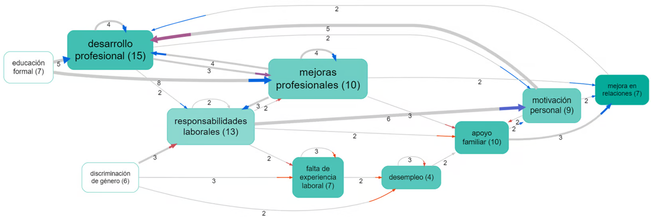
🔸
A real-world case study using Qualia
Step 2: Collecting stories with Qualia
We sent the interview link to 50 people and were able to collect 32 interviews.
We created special individual links to be able to track the interviews
We downloaded the interview results from Qualia and uploaded them into Causal Map.
Step 3: Analysing stories with Causal Map
We used AI (GPT-4o) to identify each and every causal link in the interviews, and for each link, to label the cause and effect.
We used a “radical zero-shot” approach in which the AI is given no codebook and is simply told to invent its own codes (in Spanish). We gave the AI context about the project.
We found 251 causal links mentioned by the respondents

Slide 45
References
Chopra F and Haaland I (2023) Conducting Qualitative Interviews with AI.: 72.
Jang ME and Lukasiewicz T (2023) Consistency Analysis of ChatGPT. arXiv preprint arXiv:2303.06273. Epub ahead of print 2023. DOI: https://doi.org/10.48550/arXiv.2303.06273.
Ray PP (2023) ChatGPT: A comprehensive review on background, applications, key challenges, bias, ethics, limitations and future scope. Internet of Things and Cyber-Physical Systems 3.
Yuen M (2022) Chatbot market in 2022: Stats, trends, and companies in the growing AI chatbot industry. Insider Intelligence. https://www.insiderintelligence.com/insights/chatbot-market-stats-trends/

